Slide 1
Chapter 17 Fatty Acid Catabolism

Slide 2
1. The good and bad sides of using triacylglycerols as an energy storage
Highly reduced, with an energy of complete oxidation more than twice that for the same weight of carbohydrates or proteins (~38 kJ/g vs ~18 kJ/g).
Highly hydrophobic: does not raise osmolarity of cytosol, nor add extra weight; but must be emulsified before digestion and transported by special proteins in blood.
Chemically inert: no undesired chemical reactions with other constituents; but must be activated (by attaching the carboxyl group to coenzyme A) to break the stable C-C bonds.

Slide 3
Fatty acids is a central energy source in animals (especially the liver, heart, and resting skeletal muscle), many protists, and some bacteria; the only energy source for hibernating animals and migrating birds; not a major energy source in plants.
Sources for cells to obtain fatty acids: diet; stored lipid droplets; synthesized from the excess carbohydrates and amino acids by some special organs (e.g., liver).

Slide 4
2. Dietary triacylglycerols are emulsified and absorbed by the intestine
Bile salts (e.g., taurocholate牛黄胆酸and glycocholate甘胆酸), synthesized from cholesterol in liver, emulsifies macroscopic fat particles into microscopic mixed micelles for better lipase action and absorption.
Fatty acids generated from triacylglycerol (catalyzed by the intestinal lipase) diffuse into intestinal epithelial cells, be reconverted into triacylglycerol, and packed with cholesterol esters and specific apolipoproteins in chylomicrons (乳糜微滴).

Slide 5
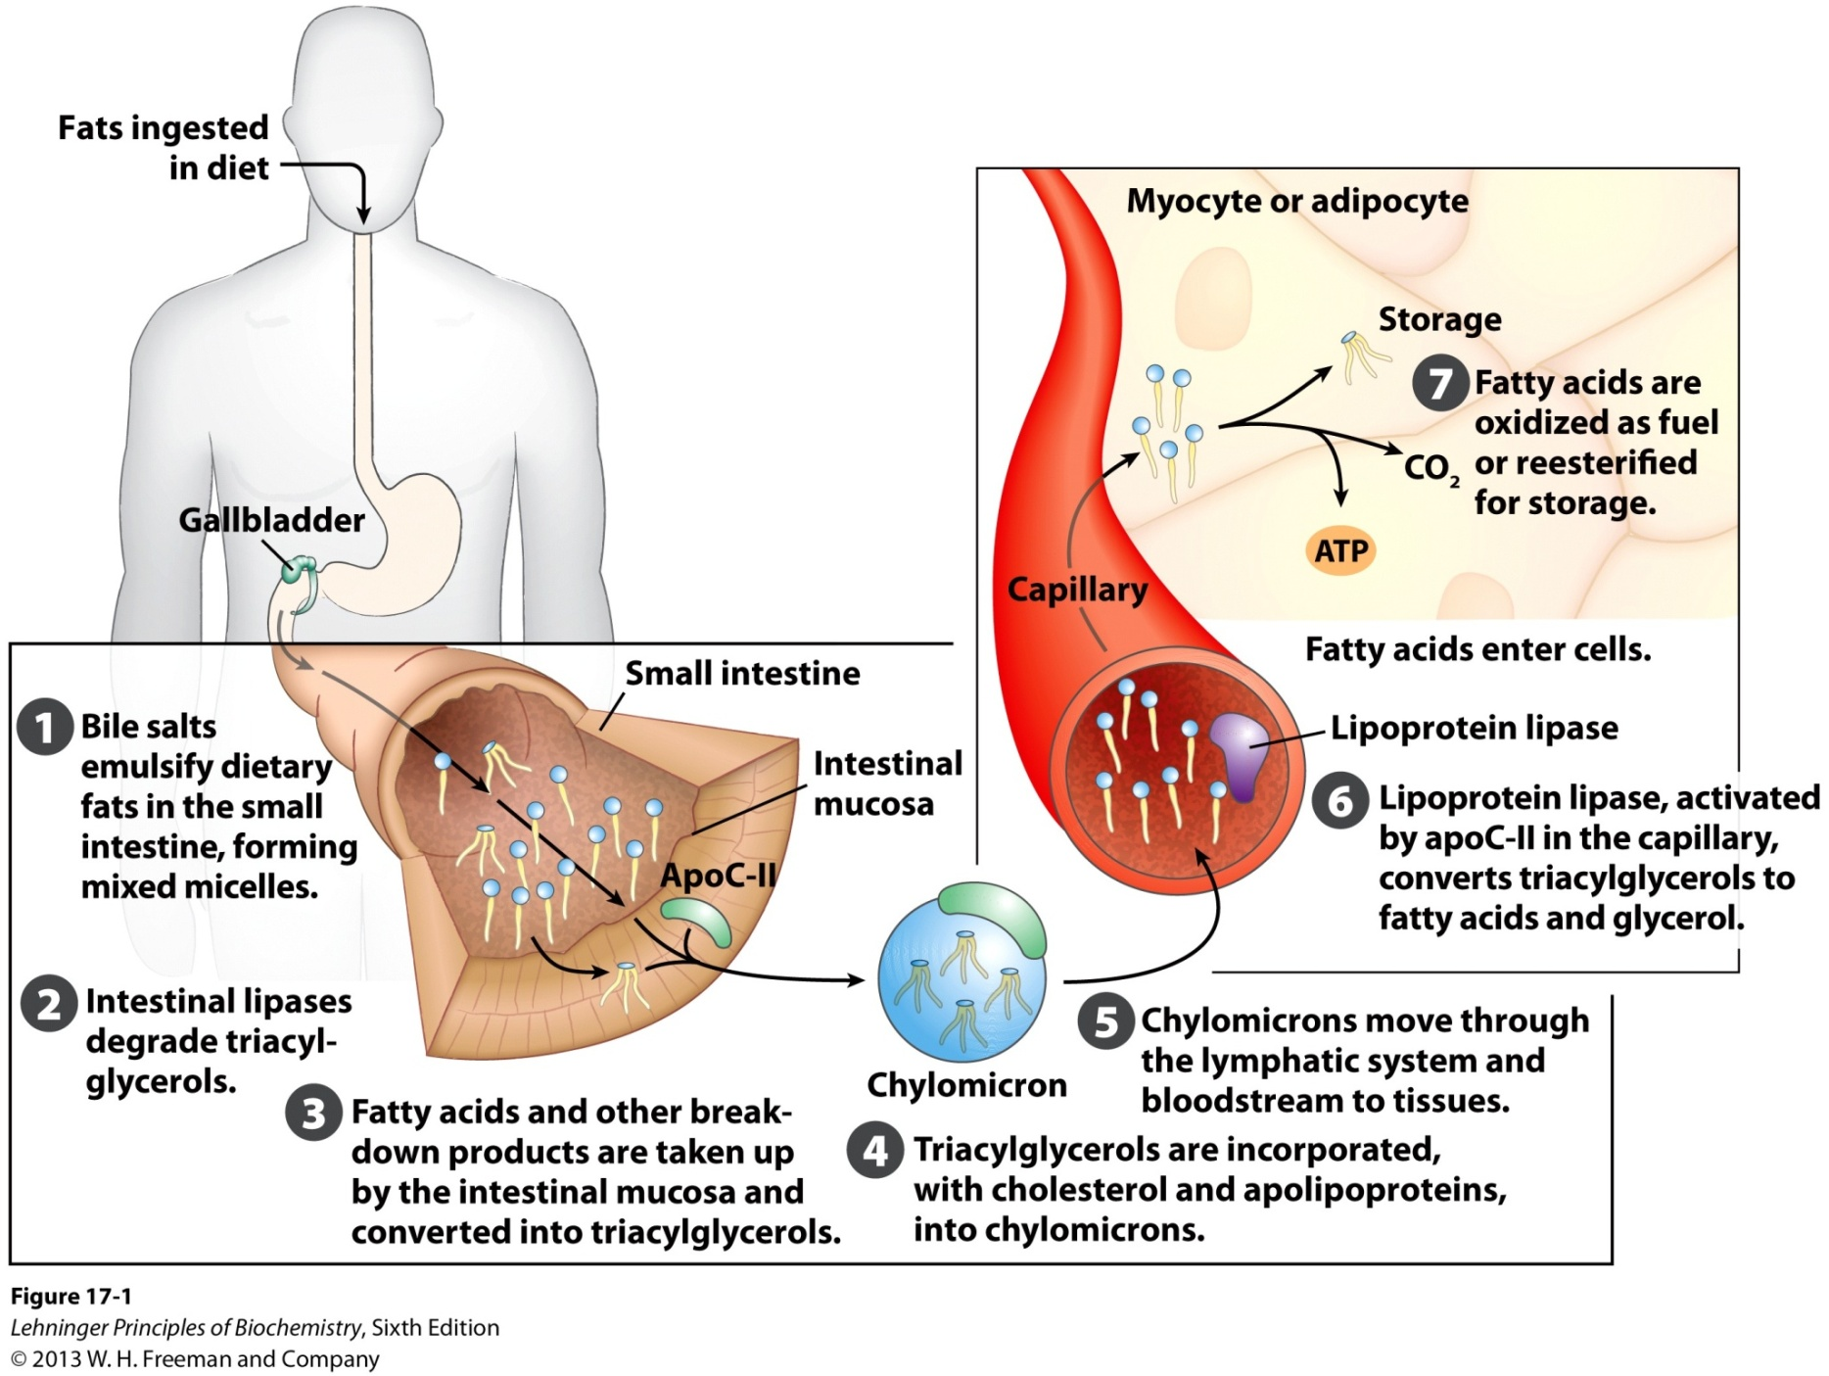
Processing of dietary lipids in vertebrates

Slide 6
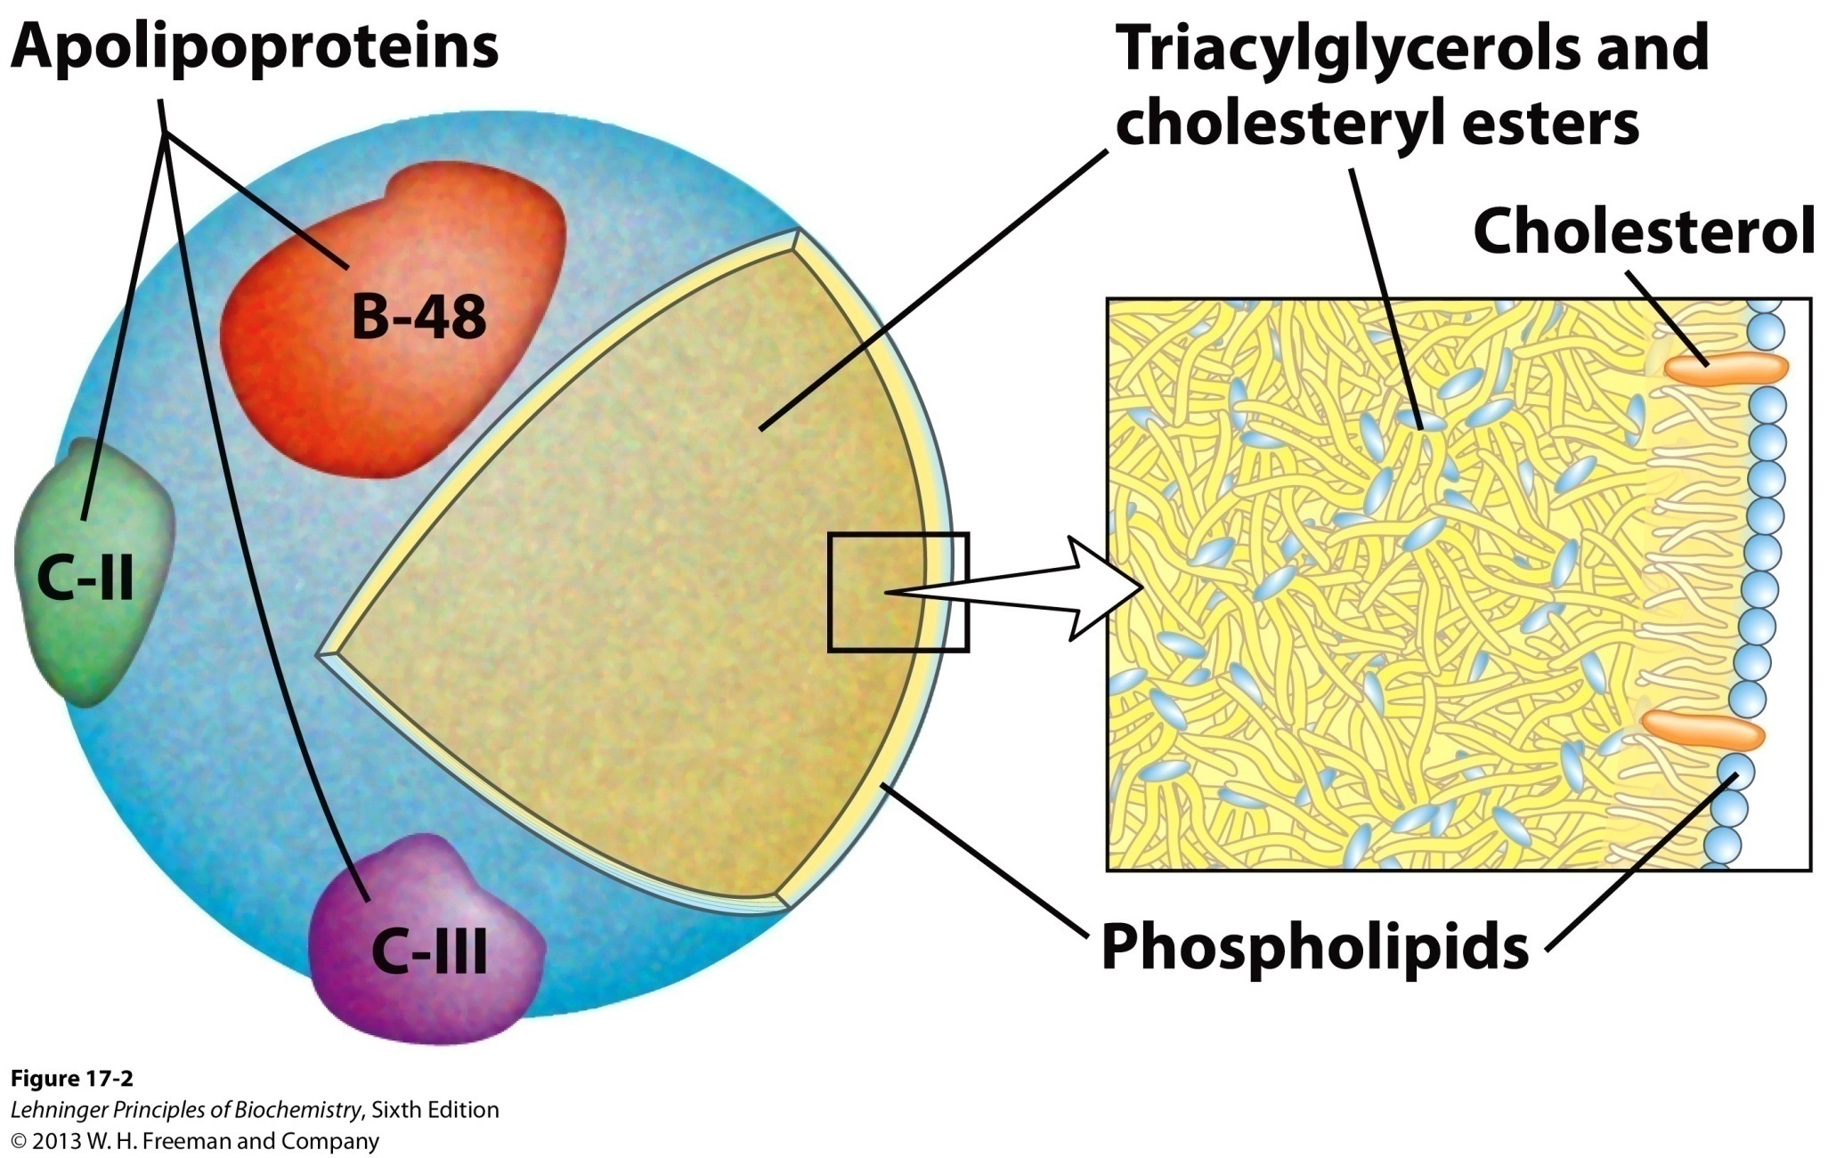
Molecular structure of a chylomicron

Slide 7
Triacylglycerols are converted into fatty acids and glycerol in the capillaries by the action of lipoprotein lipases activated by apoC-II on chylomicrons, which in turn are absorbed mainly by adipocytes and myocytes for storage and energy consumption.
The leftover of the chylomicrons (containing mainly cholesterol and apolipoproteins) will be taken up by the liver by endocytosis; triacylglycerols will be used as the energy source for the liver cells, converted to ketone bodies or transported to adipose tissues after being packed with apolipoproteins.

Slide 8
3. Mobilization of stored triacylglycerols in adipocytes needs hormone to signal the demand
The hormones epinephrine and glucagon, signaling a lack of glucose in the blood, will bind to receptors on adipocyte surface and activate the hormone-sensitive lipase and perilipin molecules on the surface of the lipid droplets.
Fatty acids released are carried to energy-demanding tissues (e.g., skeletal muscle, heart, and renal cortex) via the 62 kD monomeric serum albumin (each binding as many as 10 fatty acids).

Slide 9
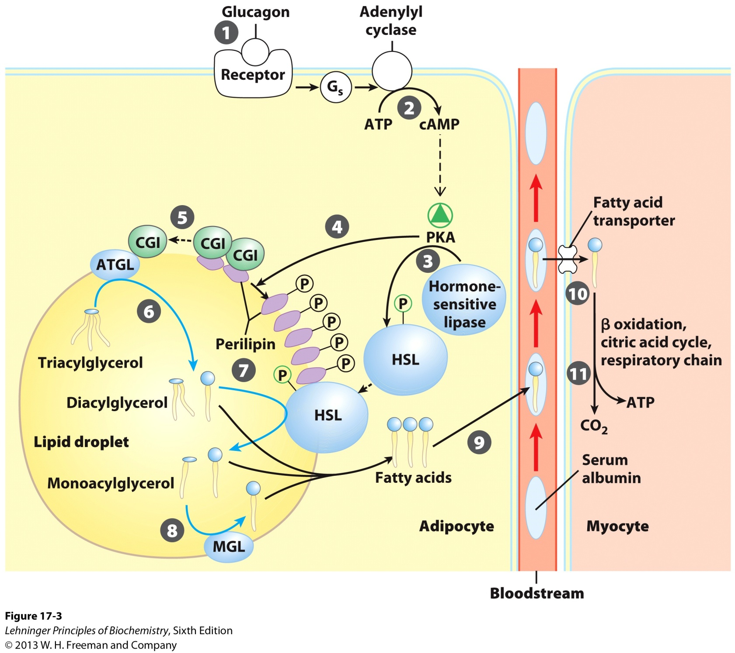
ATGL: adipose triacylglycerol lipase
HSL: hormone-sensitive lipase
MGL: monoacylglycerol lipase
Mobilization of triacylglycerols stored in adipose tissue

Slide 10
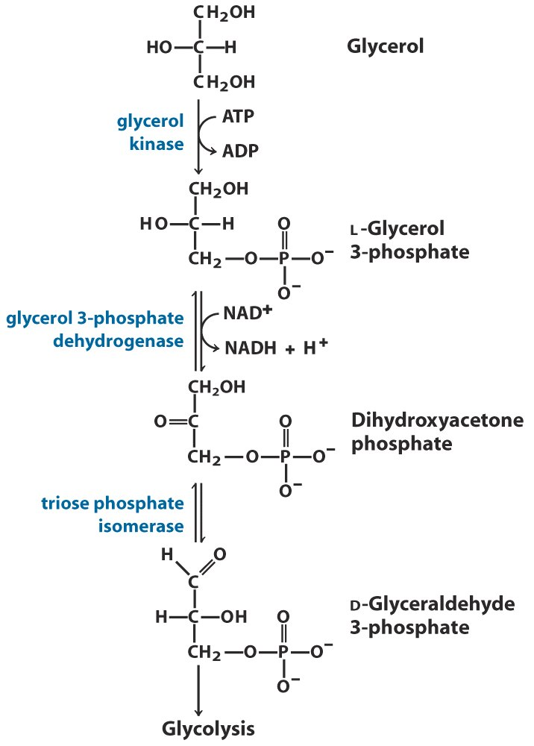
Entry of glycerol
into the glycolytic
pathway

Slide 11
4. Early labeling experiments (1904): fatty acids are degraded by sequential removal of two-carbon units
When dogs were fed with odd-numbered fatty acids attached to a phenyl group, benzoate was excreted; and when fed with even-numbered, phenylacetate was excreted.
Hypothesis: the β-carbon is oxidized, with two-carbon units released by each round of oxidation.
These experiments are a landmark in biochemistry, in using synthetic label (the phenyl group here) to elucidate reaction mechanism, and was done long before radioisotopes was used in biochemistry!

Slide 12
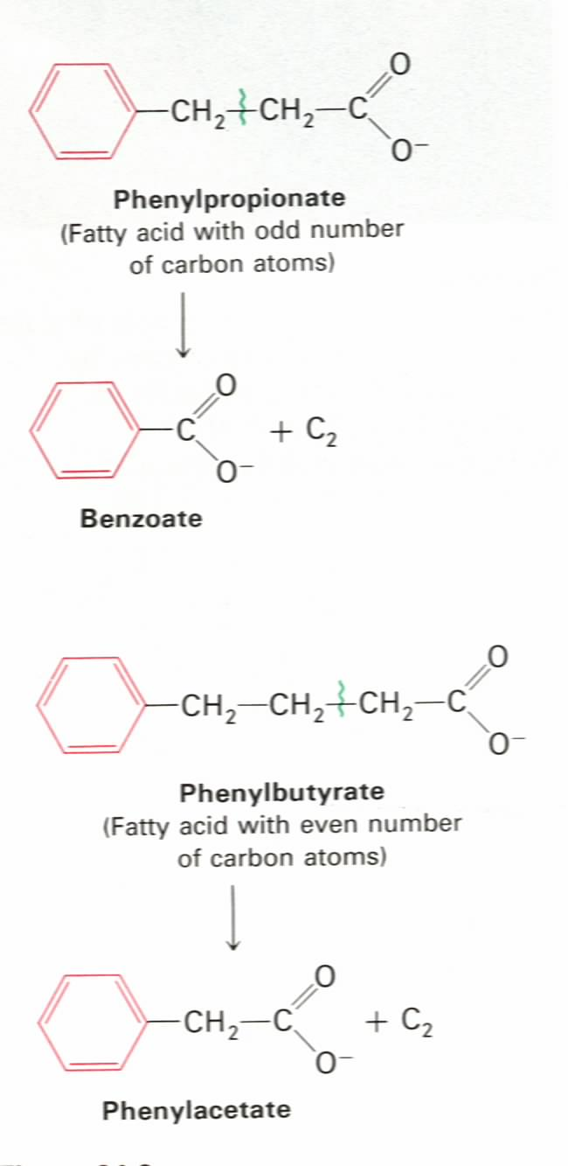
β
α
Franz Knoop’s labeling
experiments (1904):
fatty acids are degraded
by oxidation at the β
carbon, i.e., β oxidation
β
α

Slide 13
5. Fatty acid oxidation was found to occur in mitochondria
Enzymes of fatty acid oxidation in animal cells were localized in the mitochondria matrix.
Revealed by Eugene Kennedy and Albert Lehninger in 1948.

Slide 14
6. Fatty acids are activated on the outer membrane of mitochondria
Fatty acids are converted to fatty acyl-CoA (a high energy compound) via a fatty acyl-adenylate intermediate (enzyme-bound, mixed anhydride) by the action of fatty acyl-CoA synthetase (also called fatty acid thiokinase).
Pyrophosphate is hydrolyzed by inorganic pyrophosphatase, thus two anhydride bonds of ATP are consumed to form one high-energy thioester bond, thus pulling the reaction forward: a common phenomena in biosynthetic reactions.
Acyl-adenylates are often formed when –COOH groups are activated in biochemistry.

Slide 15
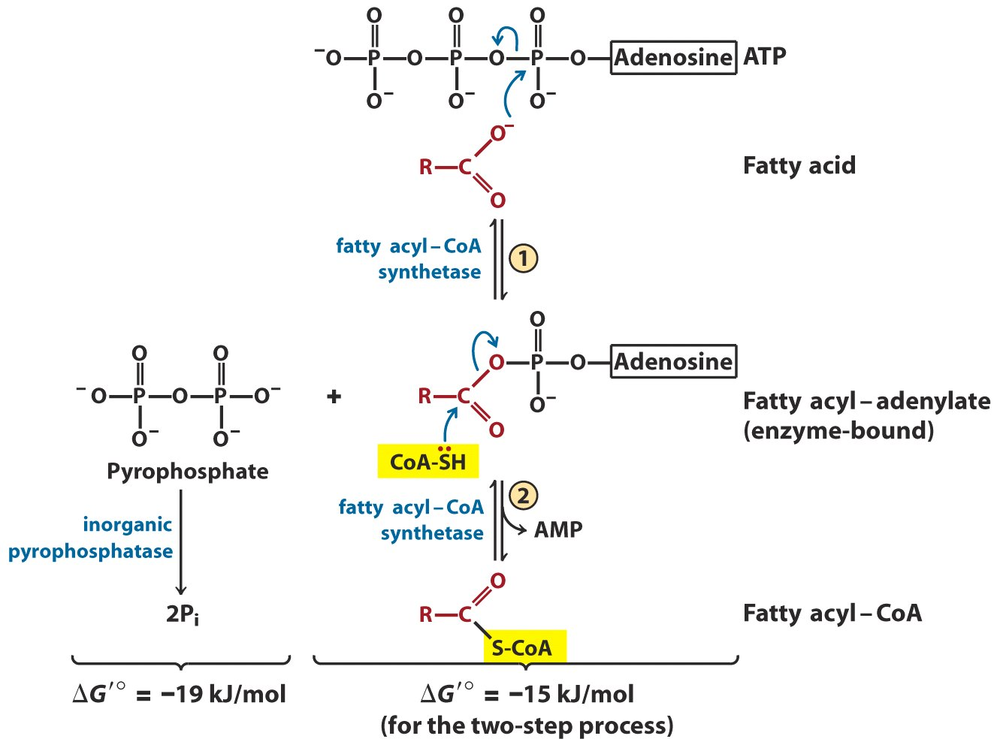
Conversion of a fatty acid to a fatty acyl-CoA

Slide 16
7. Activated (long chain) fatty acids are carried into the matrix by carnitine
The fatty acyl group is attached to carnitine (肉碱) via transesterification by the action of carnitine acyltransferase I located on the outer membrane of mitochondria, forming fatty acyl-carnitine, leaving the CoA in the cytosol.
The acyl carnitine/carnitine transporter moves acyl-carnitine across the inner membrane of mitochondria via facilitated diffusion.
Medium-chain acyl-CoAs seem to enter the matrix by themselves, without being carried by carnitine.

Slide 17
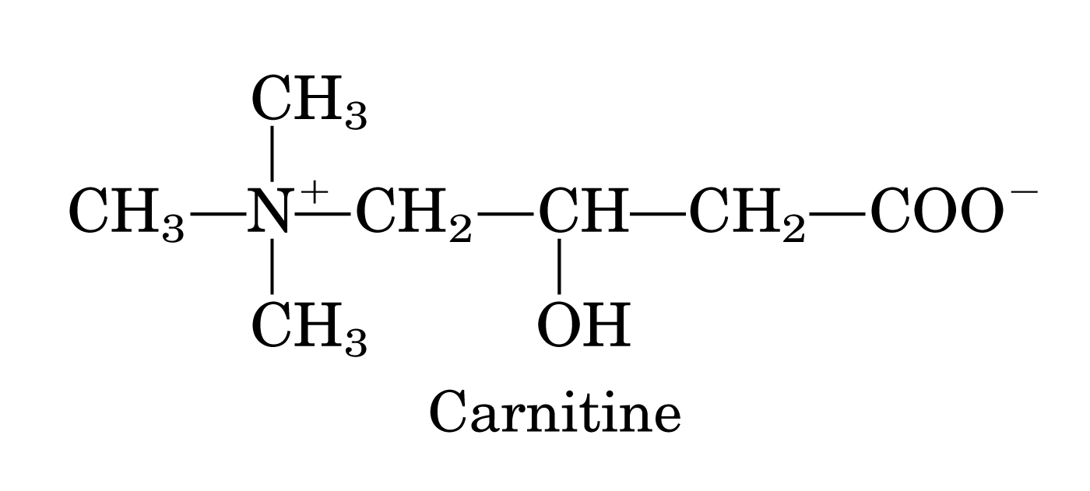

Slide 18
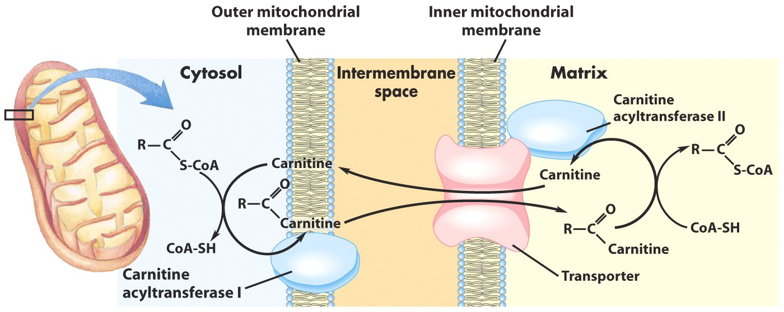
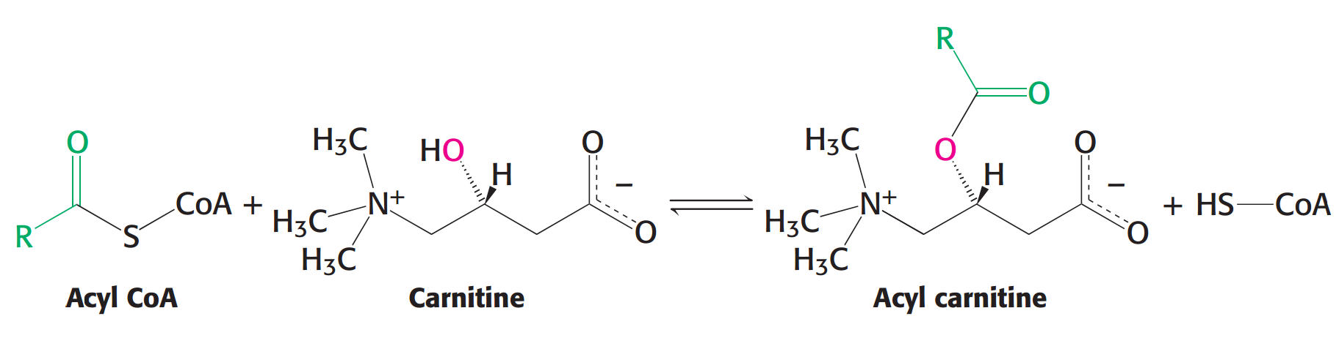
Fatty acid entry into mitochondria
via the acyl-carnitine/carnitine transporter

Slide 19
The acyl group is then transferred back to CoA to form fatty acyl-CoA by the action of carnitine acyltransferase II located on the inner face of the inner membrane.
This entering step seems to be rate-limiting for fatty acid oxidation in mitochondria and diseases have been found to be caused by a defect of this step (with aching muscle cramp, especially during fasting, exercise or when on a high-fat diet).

Slide 20
8. Fatty acyl-CoA is oxidized to acetyl-CoA via multiple rounds of β oxidation
The β oxidation consists of
four reactions:
dehydrogenation
hydration
dehydrogenation
thiolytic cleavage

Slide 21
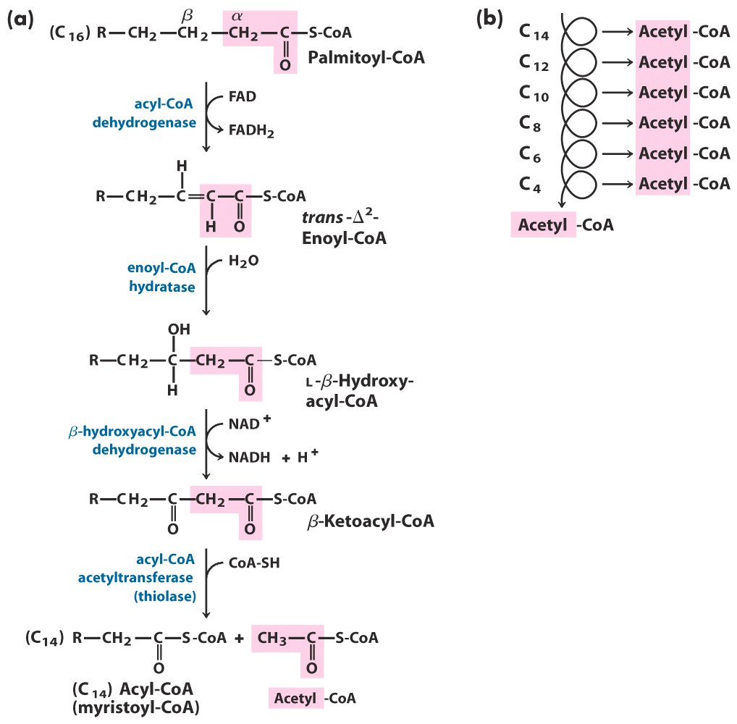
The β-oxidation pathway

Slide 22
The 1st dehydrogenation is catalyzed by the membrane-bound acyl-CoA dehydrogenase, converting acyl-CoA to trans-Δ²-enoyl-CoA with electrons collected by FAD and further transferred into the respiratory chain via the electron-transferring flavoprotein (ETF), also bound to the inner membrane of the mitochondria.
Acyl-CoA dehydrogenase exists in three isozymes acting on the acyl-CoAs of long (12-18C), medium (4-14C) and short (4-8C) chains.

Slide 23
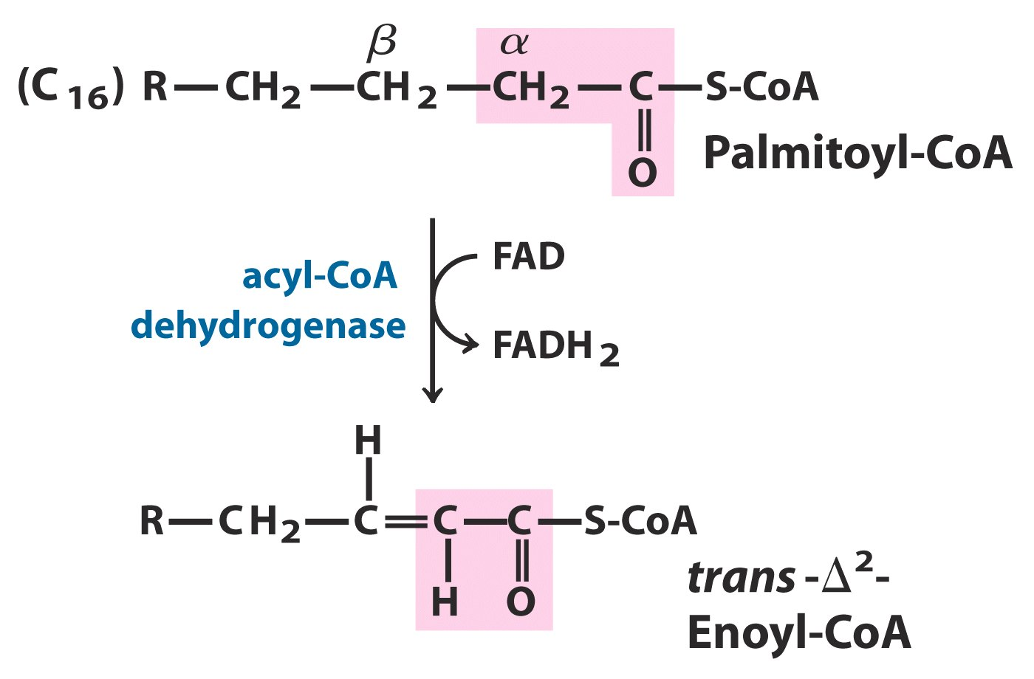

Slide 24
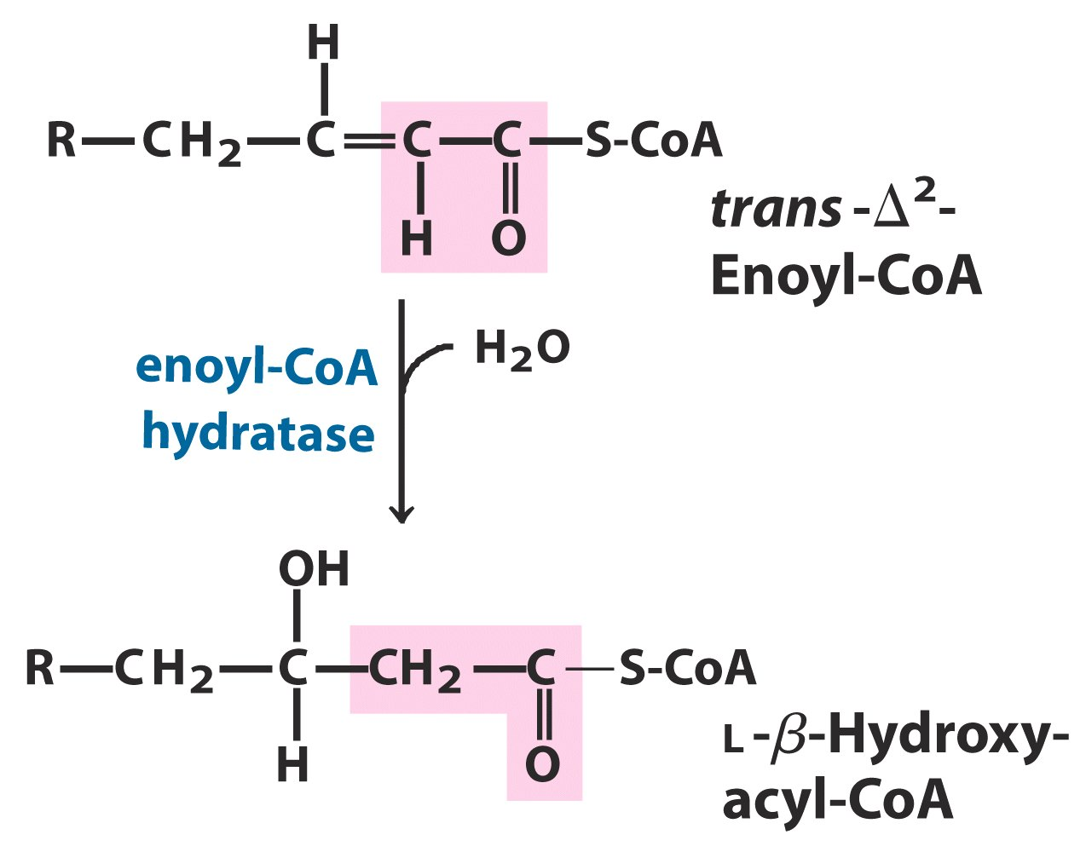
The hydration step, stereospecifically catalyzed by
enoyl-CoA hydratase, converts the
trans-Δ2-enoyl-CoA to L-β-hydroxylacyl-CoA.

Slide 25
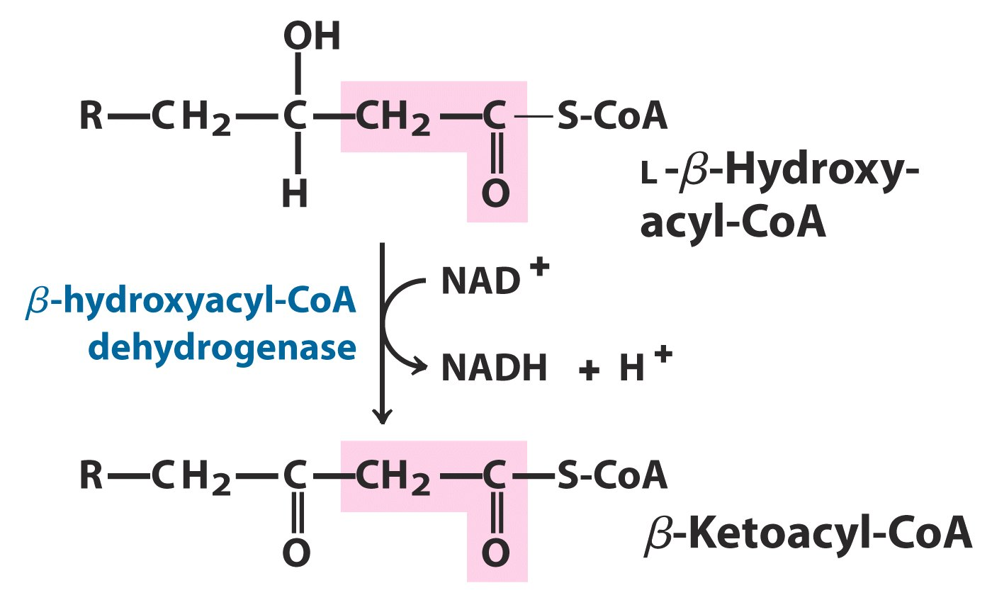
The 2nd dehydrogenation is catalyzed by
L-β-hydroxylacyl-CoA dehydrogenase,
converting L-β-hydroxylacyl-CoA to
β-ketoacyl-CoA, with electrons collected by NAD⁺.

Slide 26
The acyl-CoA acetyltransferase (or commonly called thiolase) catalyzes the nucleophilic attack of CoA to the carbonyl carbon, cleaving β-ketoacyl-CoA between the α and β carbon (thiolysis), generating two acyl-CoA molecules with one entering the citric acid cycle and the other reentering the β oxidation pathway.
The first three reactions of the β oxidation used the same reaction strategy as the last three reactions in the citric acid cycle, all involving the oxidation of a highly reduced carbon (from -CH₂- to -CHO-).

Slide 27
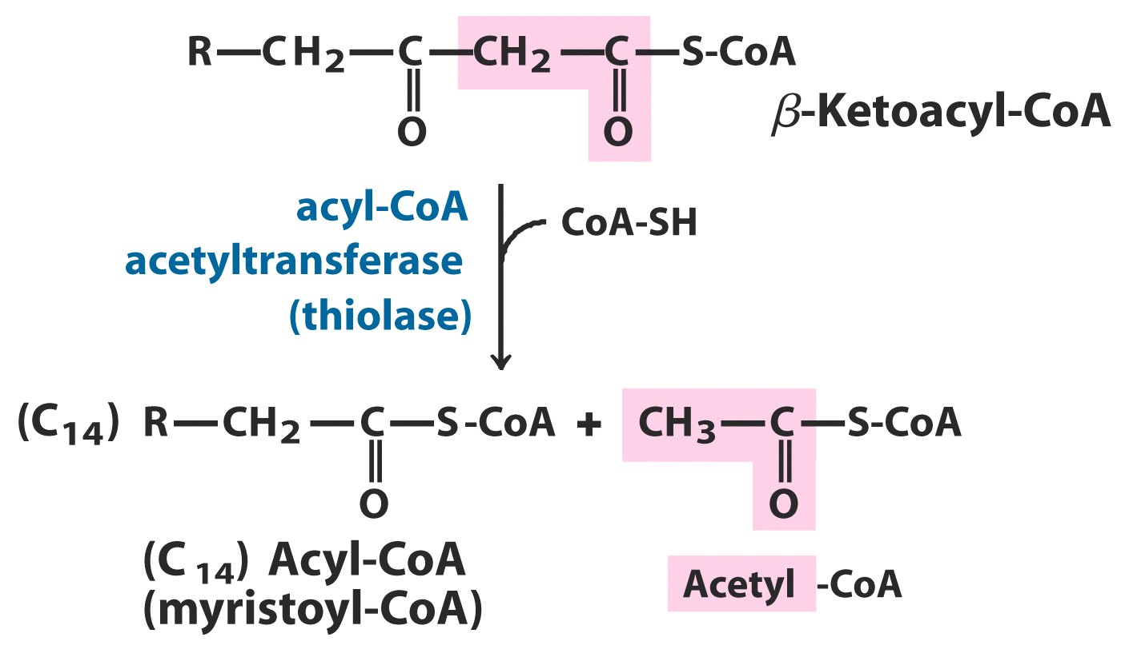

Slide 28
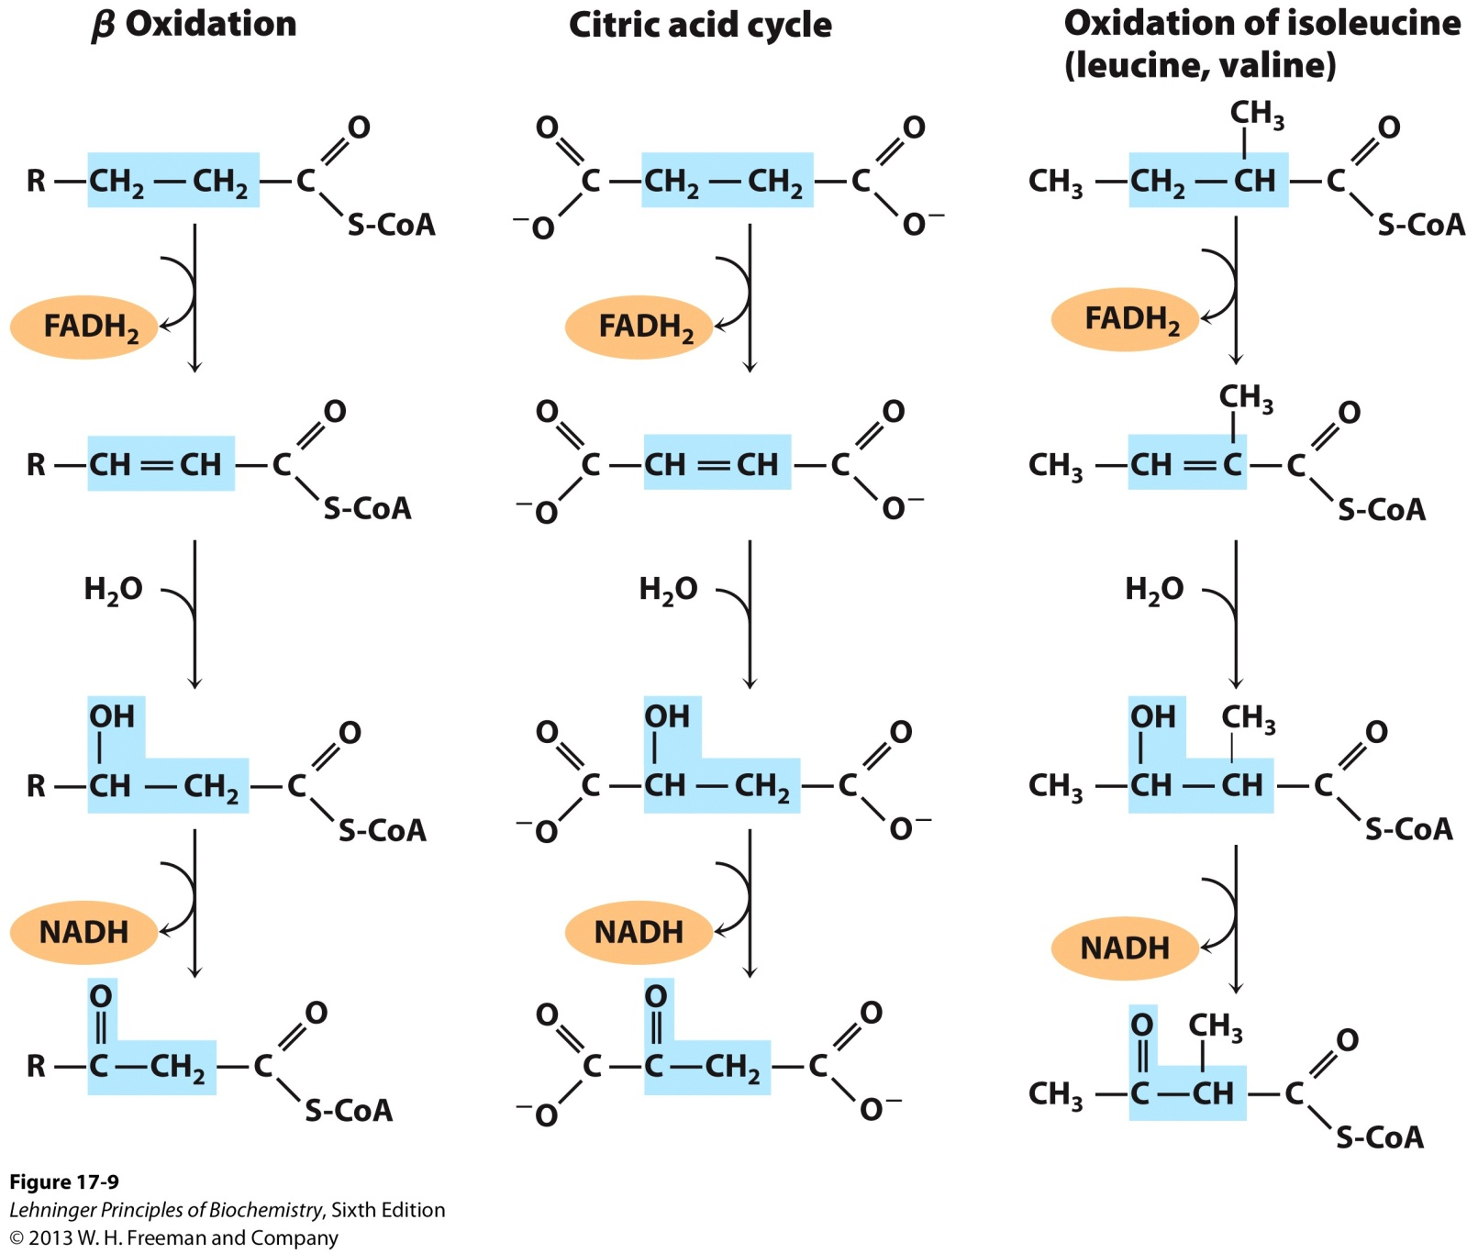
A conserved reaction sequence to induce a carbonyl
function on the carbon β to a carboxyl group

Slide 29
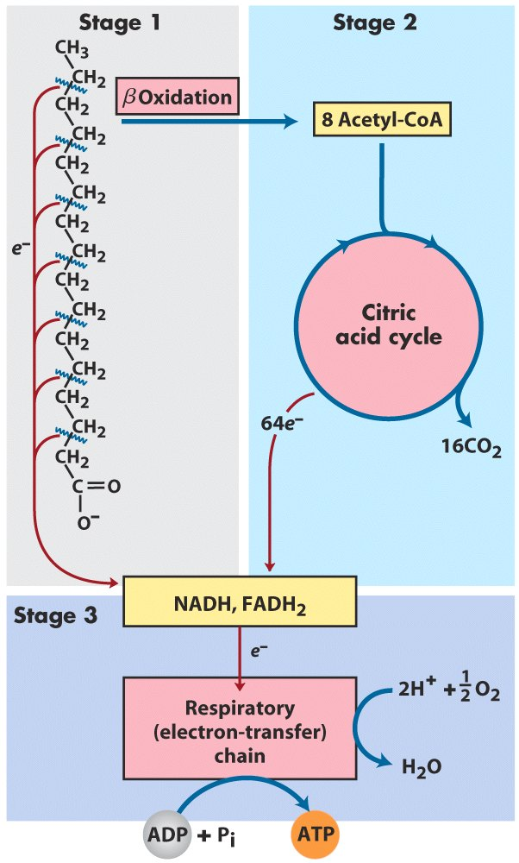
Stages of fatty
acid oxidation

Slide 30
Palmitol-CoA + 7CoA + 7FAD + 7NAD⁺ + 7H₂O
8 acetyl-CoA + 7FADH₂ + 7NADH + 7H⁺
The complete oxidization of each 16-carbon
palmitate (to H₂O and CO₂) yields ~106 ATP
(~32 ATP per glucose, both having about
60% of actual energy recovery).

Slide 31
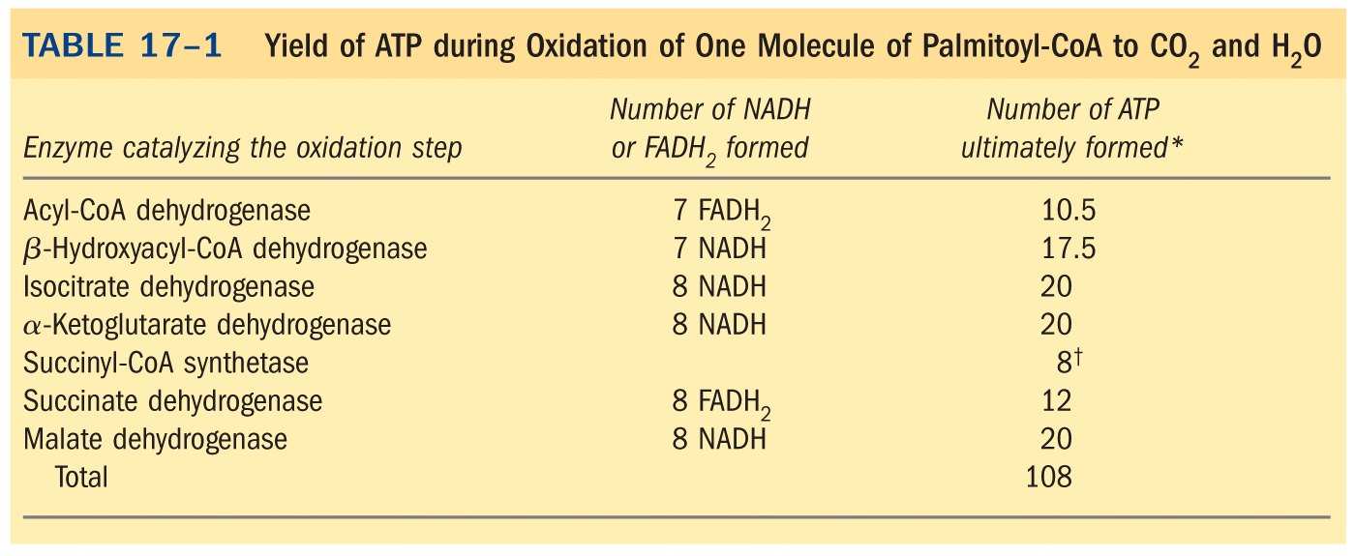
*****
Palmitoyl-CoA+23O₂+108P_{i}+108ADP
CoA+108ATP+16CO₂+23H₂O

Slide 32
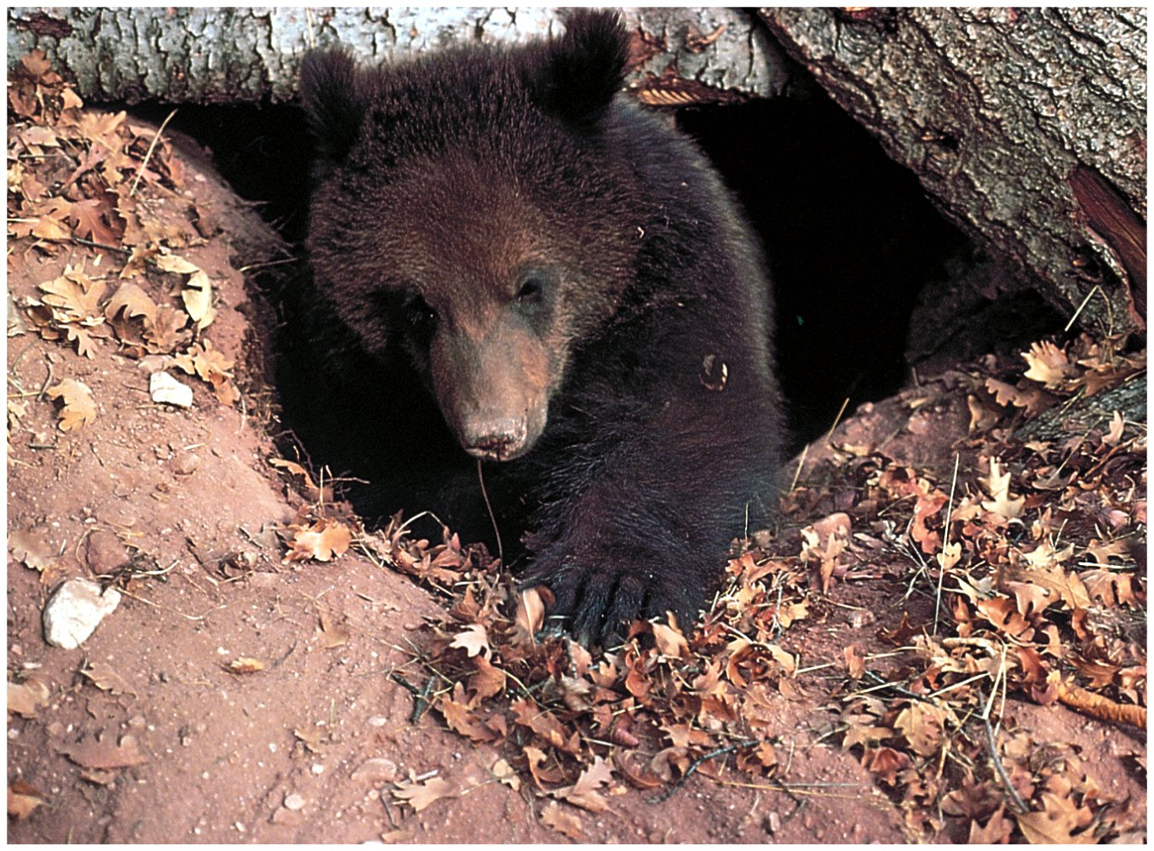
Hibernating grizzly bears use body fat as their sole fuel

Slide 33
9. Oxidation of unsaturated fatty acids requires one or two auxiliary enzymes, an isomerase and a reductase
The isomerase converts a cis-Δ³ double bond to a trans-Δ² double bond.
The reductase (2,4-dienoyl-CoA reductase) converts a trans-Δ², cis-Δ⁴ structure to a trans-Δ³ structure, which will be further converted to a trans-Δ² structure by the isomerase.
NADPH is needed for the reduction (from two double bonds to one).

Slide 34
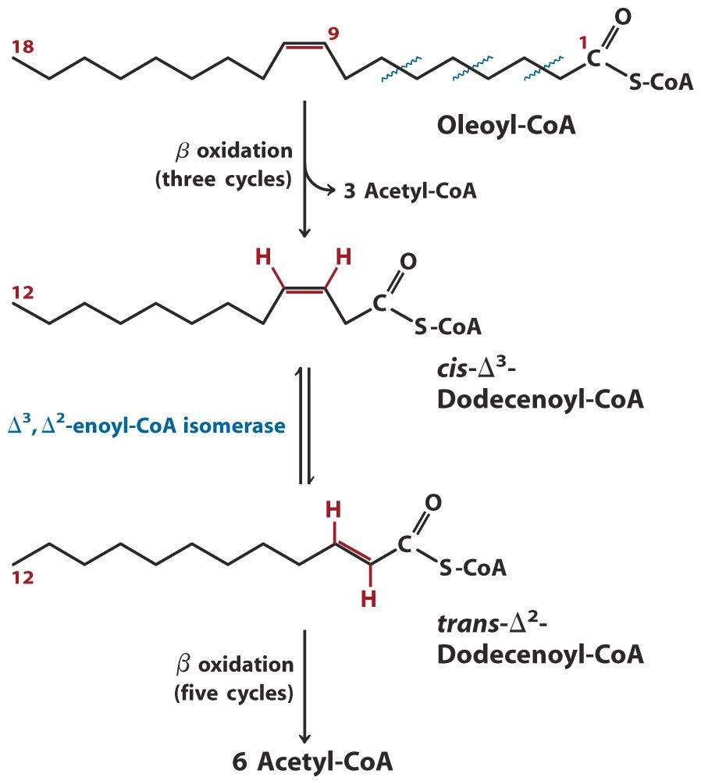
Oxidation of a
monounsaturated
fatty acid:
the enoyl-CoA
isomerase helps to
reposition the
double bond

Slide 35
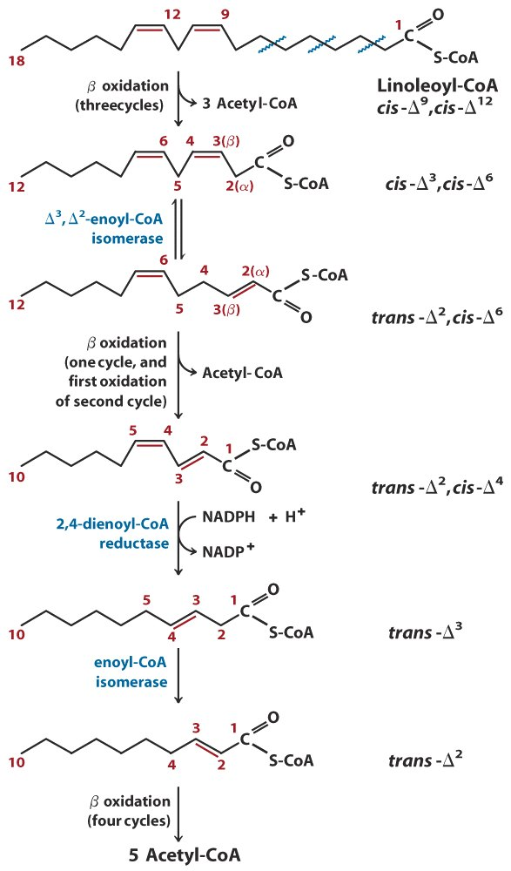
Both an isomerase and
a reductase are needed
for oxidizing a
polyunsaturated fatty
acid.

Slide 36
10. Propionyl-CoA generated from odd-number fatty acids (and three amino acids) is converted to succinyl-CoA
Odd-number fatty acids, commonly found in the lipids of some plants and marine organisms, will also be oxidized via the β oxidation pathway, but generating a propionyl-CoA at the last step of thiolysis.
Propionyl-CoA is converted to succinyl-CoA via an unusual enzymatic pathway of three reactions.

Slide 37
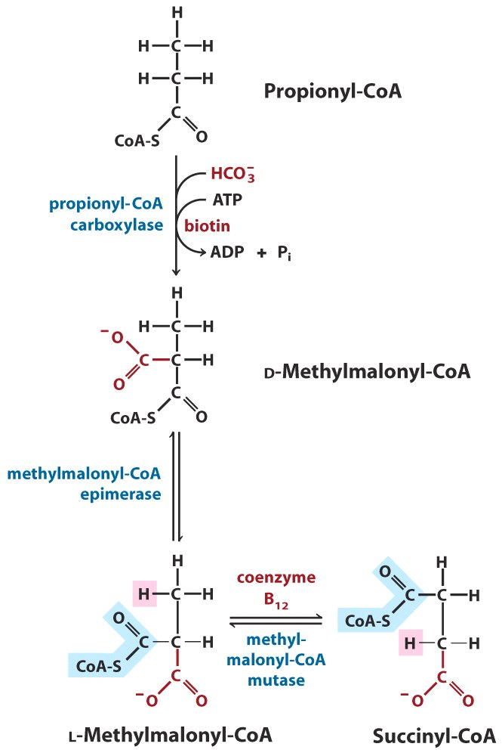
Propionyl-CoA can be
converted to succinyl-CoA
via a carboxylation,
an epimerization and
an intramolecular group
shifting

Slide 38
Propionyl-CoA is first carboxylated at the a carbon to form D-methylmalonyl-CoA, catalyzed by propionyl-CoA carboxylase.
The D-methylmalonyl-CoA is then epimerized to the L-isomer by the action of an epimerase.
The L-methylmalonyl-CoA is then converted to succinyl-CoA by an intramolecular rearrangement via free radical intermediates, with the catalysis of methylmalonyl-CoA mutase, using 5’-deoxyadenosylcobalamin (or coenzyme B₁₂) as a coenzyme.

Slide 39
Coenzyme B₁₂ enzymes act in intramolecular rearrangements, methylation, and reduction of ribonucleotides to deoxynucleotides.
Pernicious anemia (恶性贫血) is caused by a failure to absorb vitamin B₁₂, which may in turn be caused by a deficiency of the intrinsic factor, a 59 kD glycoprotein needed for vitamin B₁₂ absorption.
Vitamin B₁₂ is synthesized by a few intestinal bacteria (not plants).

Slide 40
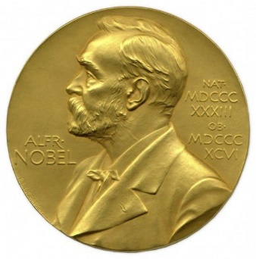
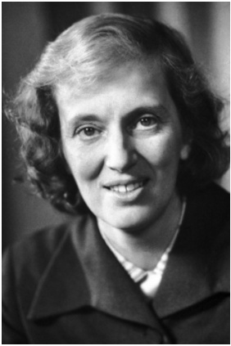
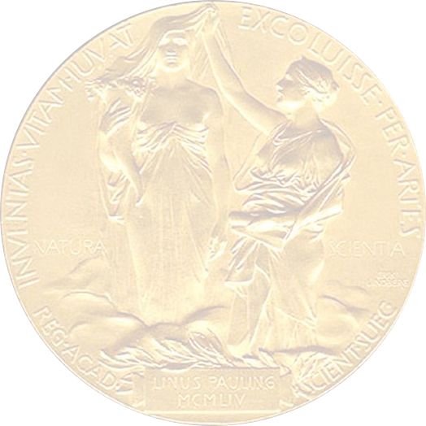
The Nobel Prize in Chemistry 1964
“for her determinations by X-ray techniques of the structures of important biochemical substances”
3-D structure of coenzyme B₁₂ and penicillin
Dorothy Crowfoot Hodgkin
Great Britain
Royal Society
Oxford University
Great Britain
1910-1994

Slide 41
11. The rate of β-oxidation in mitochondria is limited by the entering rate of fatty acyl-CoA
Fatty acyl-CoA in the cytosol can enter mitochondria for oxidative degradation or be converted to triacylglycerol in the cytosol when excess glucose is present that can not be oxidized or stored as glycogen and is converted into fatty acids for storage.
The key regulatory protein is carnitine acyltransferase I, which is inhibited by malonyl-CoA, the first intermediate for fatty acid synthesis from acetyl-CoA.

Slide 42
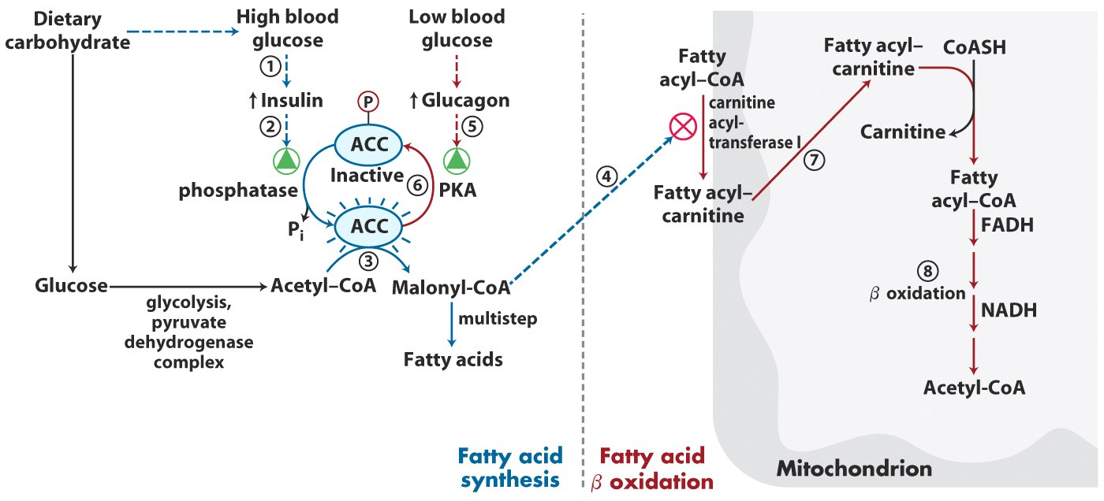
Coordinated regulation of fatty acid synthesis and breakdown

Slide 43
12. Fatty acid oxidation also occurs in peroxisomes (glyoxysomes)
Peroxisome is the principle organelle in which fatty acids are oxidized in plant cells.
Also via the four-step β oxidation pathway, but the electrons collected by FAD are directly passed to O₂, producing the harmful H₂O₂, which is immediately converted to H₂O and O₂ .
Energy released is dissipated as heat, not conserved in ATP.

Slide 44
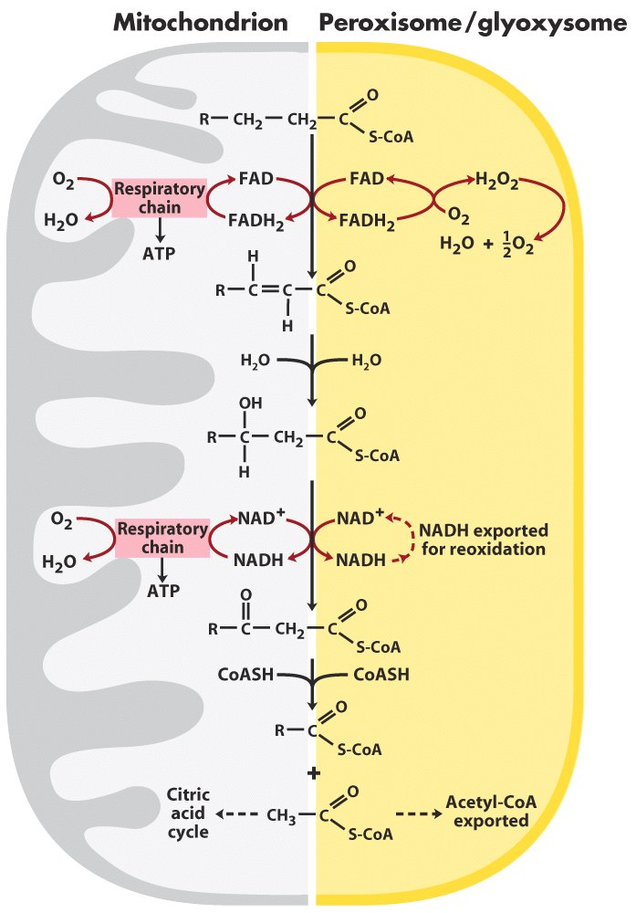
Comparison of
β-oxidation in
mitochondrion and in
peroxisome/glyoxysome

Slide 45
The acetyl-CoA produced in animal peroxisomes is transported into cytosol, where it is used in the synthesis of cholesterol and other metabolites.
The acetyl-CoA produced in plant peroxisomes/ glyoxysomes (especially in germinating seeds) is converted to succinate via the glyoxylate cycle, and then to glucose via gluconeogenesis.

Slide 46
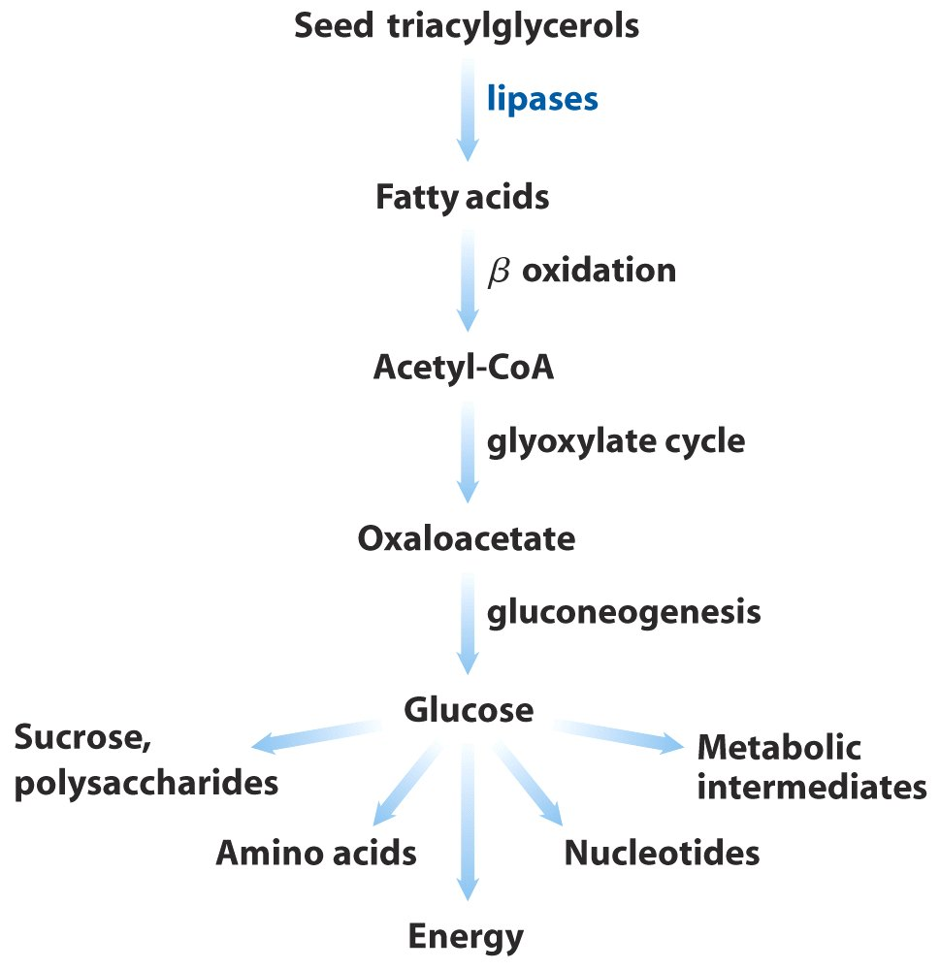
Triacylglycerols as glucose source in seeds

Slide 47
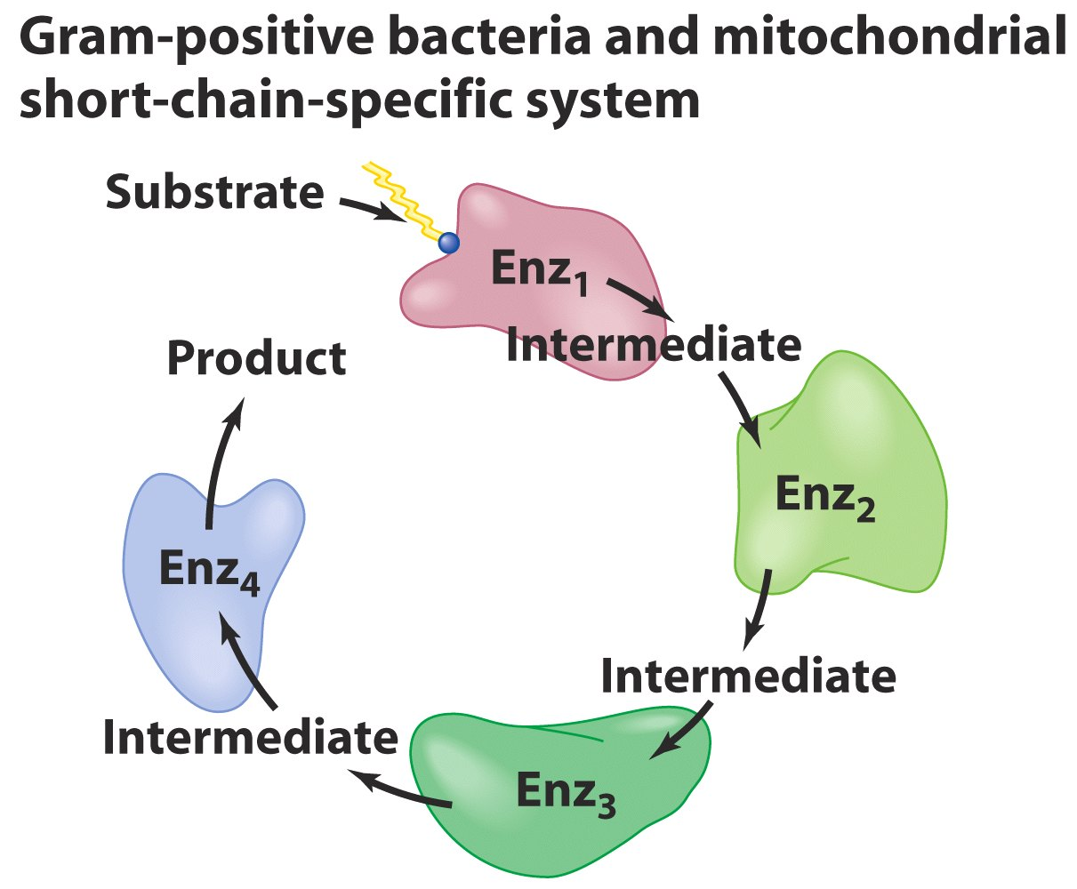
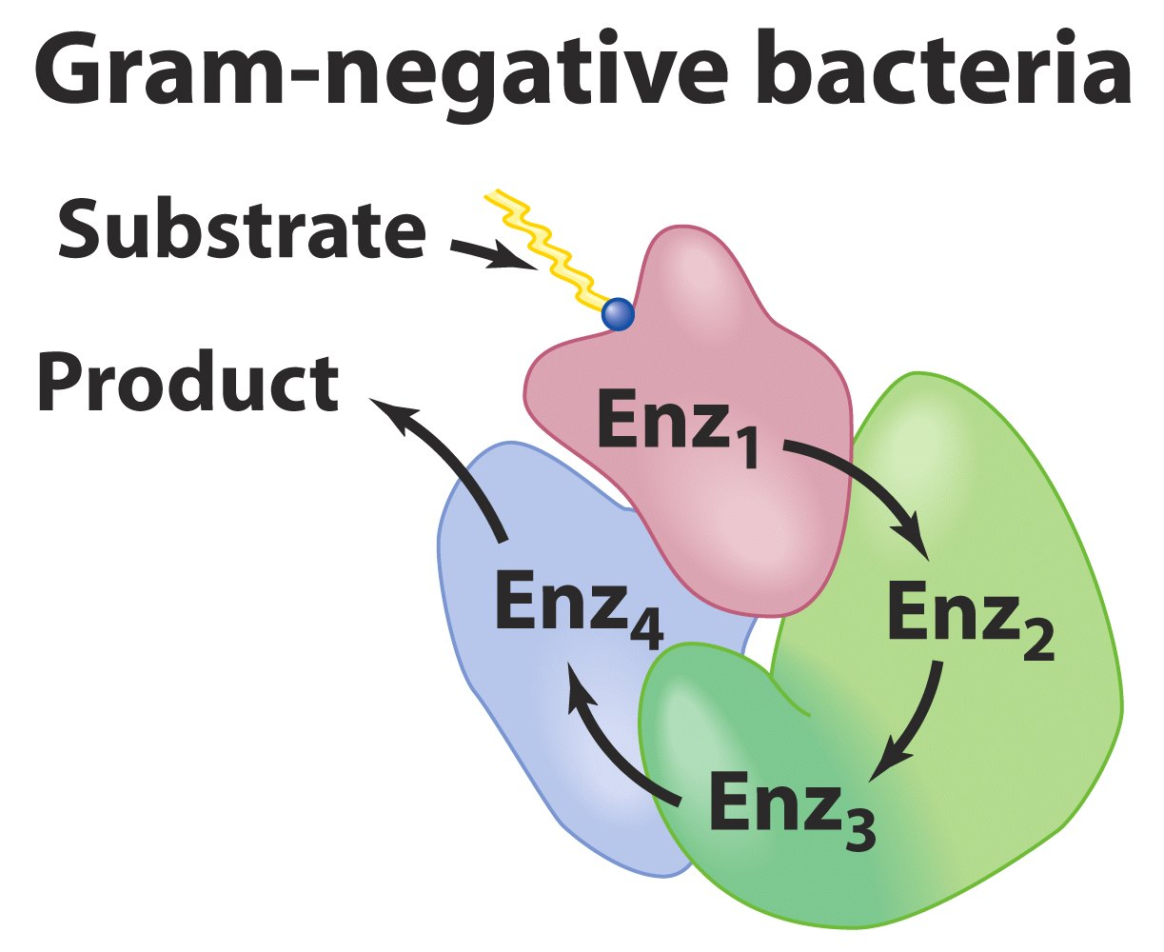
The β-oxidation enzymes in mitochondria and peroxisomes
are organized differently: being separate enzymes in
mitochondria (as in gram-positive bacteria) and one
complex in peroxisomes (as in gram-negative bacteria)

Slide 48
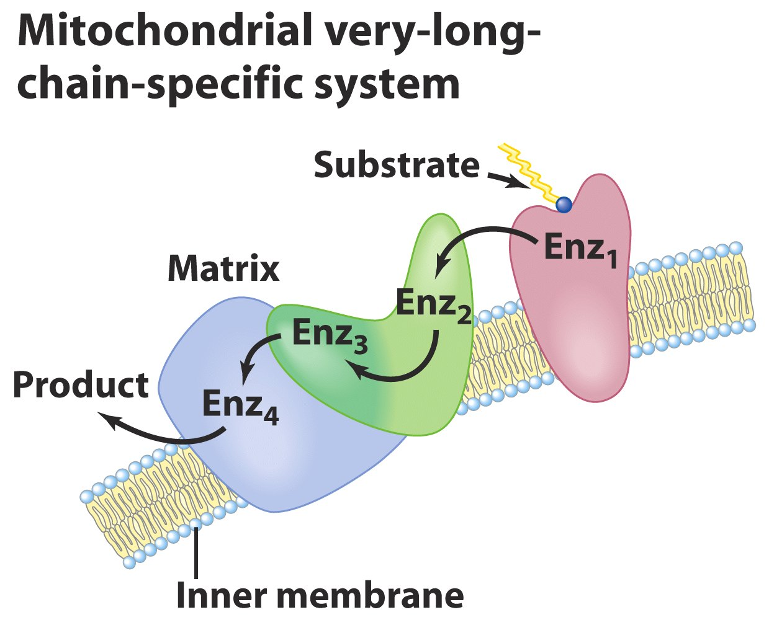
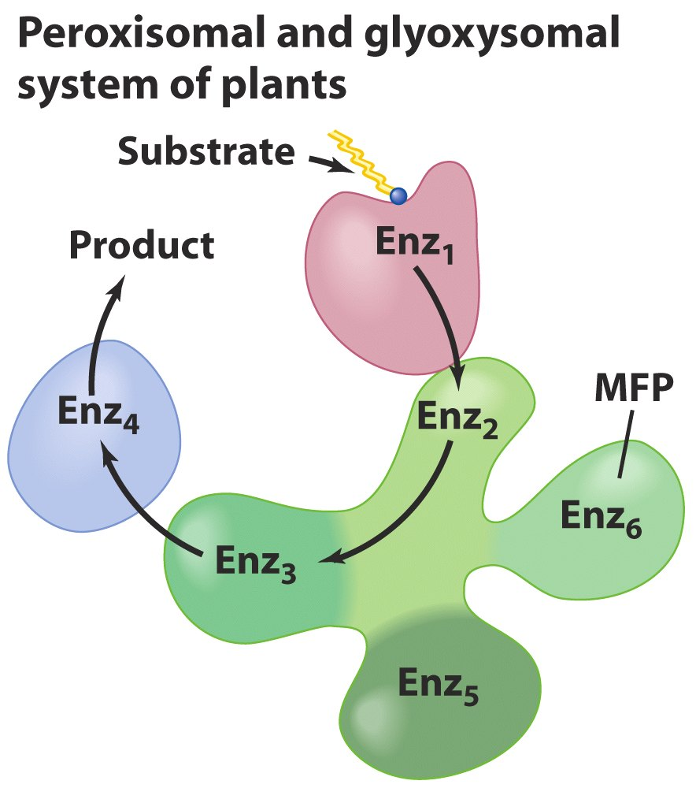
Bound to the inner
mitochondrial membrane

Slide 49
13. Acetyl-CoA in liver can be converted to ketone bodies when carbohydrate supply is not optimal
Under fasting or diabetic conditions, oxaloacetate concentration in hepatocyte will be low: the rate of glycolysis is low (thus the supply of precursors for replenishing oxaloacetate is cut off) and oxaloacetate is siphoned off into gluconeogenesis (to maintain blood glucose level).
The acetyl-CoA generated from active fatty acid oxidation can not be oxidized via the citric acid cycle and will be converted to acetoacetate,
β-hydroxylbutyrate, and acetone (i.e., the ketone bodies, 酮体) in mitochondria for export to other tissues.

Slide 50
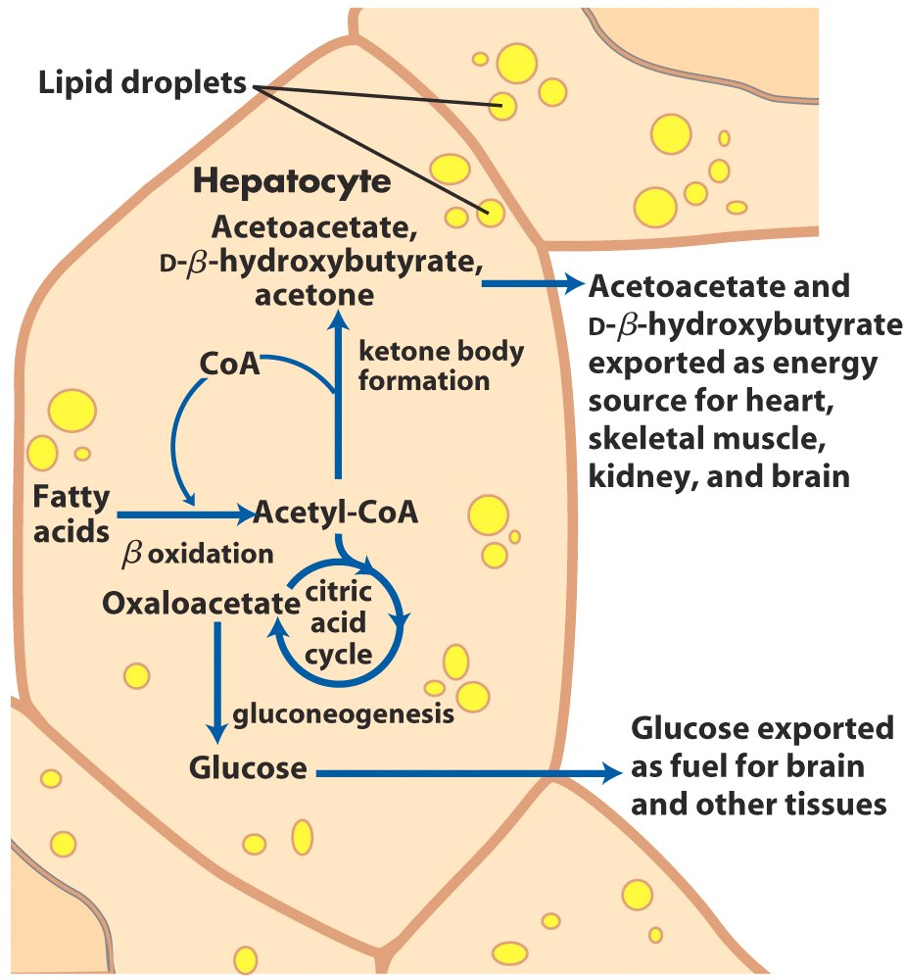
Ketone body formation and export from the liver

Slide 51
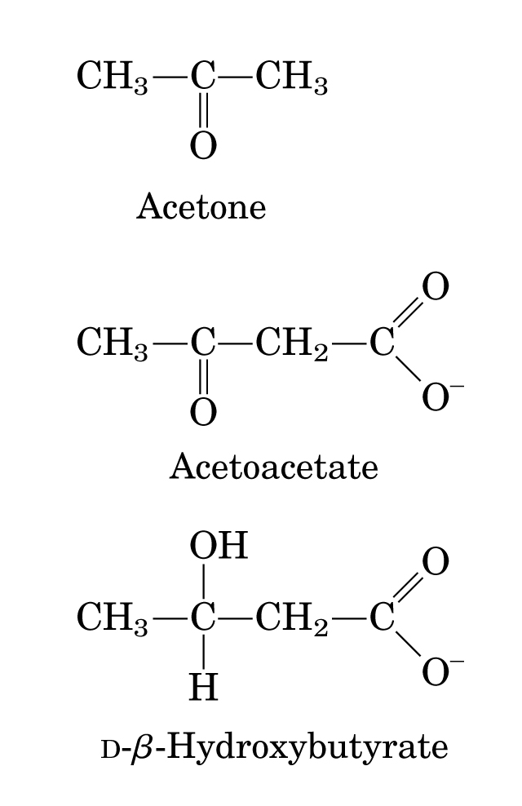

Slide 52
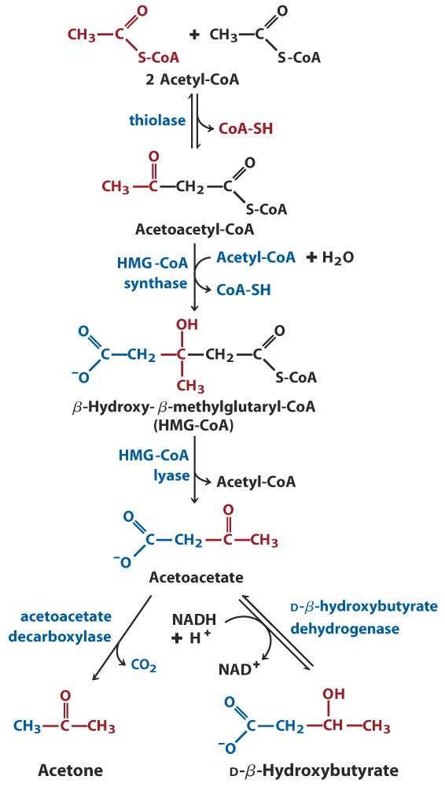
Formation of ketone bodies from acetyl-CoA

Slide 53
14. Ketone bodies are converted back to acetyl-CoA in extrahepatic tissues
D-β-hydroxylbutyrate is reoxidized to acetoacetate (catalyzed by the dehydrogenase).
Acetoacetate is then converted to acetoacetyl-CoA using succinyl-CoA (catalyzed by β-ketoacyl-CoA transferase).
Acetoacetyl-CoA is cleaved to two acetyl-CoA (again catalyzed by thiolase).
Heart, skeletal muscle and the renal cortex use acetoacetate in preference to glucose.
The brain adapts to the utilization of acetoacetate during starvation and diabetes.

Slide 54
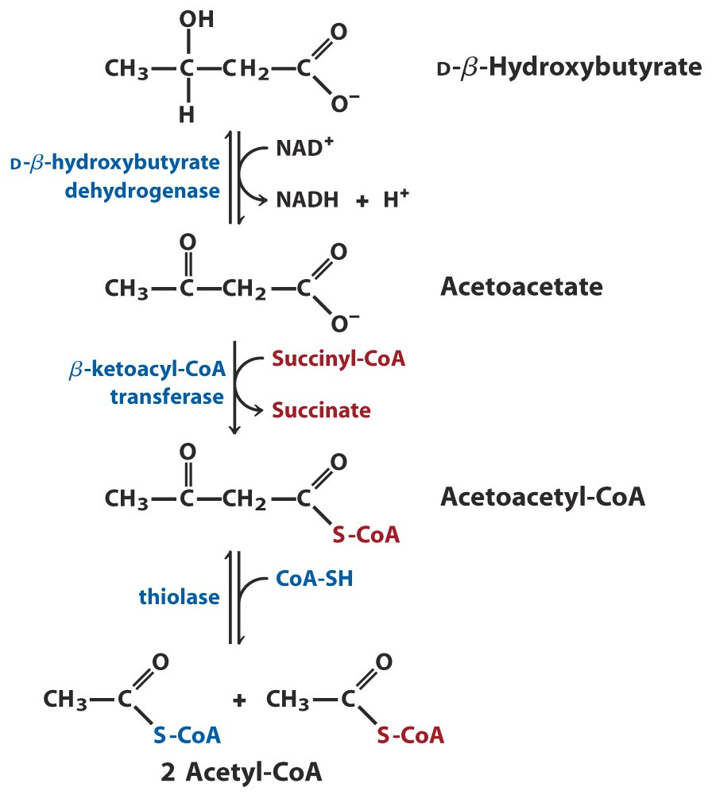
Not present
in liver
β-Hydroxybutyrate can be used as a fuel by extrahepatic tissues

Slide 55
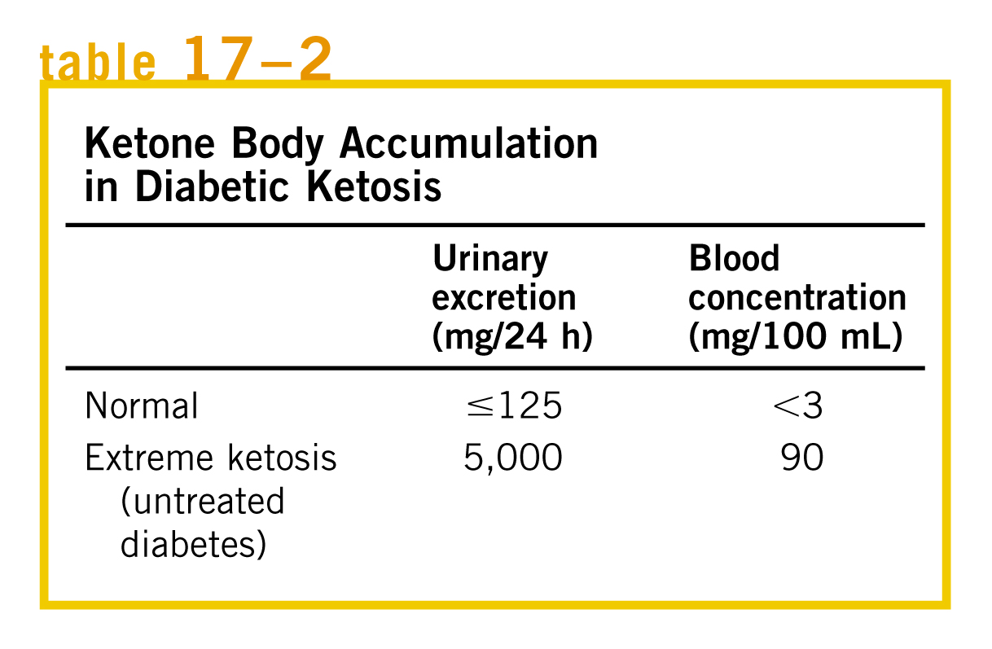
Overproduction of ketone bodies in uncontrolled diabetes or severely reduced calorie intake can
lead to acidosis and ketosis.

Slide 56
Keywords
Activation and transport of fatty acids
β-oxidation --- reaction and regulation
Ketone bodies

Slide 57
Words of the week
ketosis
acidosis
ketoacidosis
alkalosis

Slide 58
Text-book reading of the week
Summary 17.1 (p672)
Summary 17.2 (p686)
Summary 17.3 (p688)
p686-688 (ketone bodies)

Slide 59
Summary
Diet triacylglycerols are emulsified by bile salts in the intestines before being absorbed and transported in blood as chylomicron particles.
Stored triacylglycerols are mobilized in response to hormones and fatty acids in blood are carried by serum albumin.
Fatty acids are activated to the acyl-CoA form and is then carried into mitochondria by carnitine with the help of two carnitine acyltranseferase isozymes (I and II) located on the outside and inside of the inner membrane.
Acyl-CoA is converted to acetyl-CoA after going through multiple rounds of the four-step (dehydrogenation, hydration, dehydrogenation and thiolysis) β-oxidation pathway.

Slide 60
Oxidative degradation of unsaturated fatty acids need two extra enzymes: an isomerase and a reductase.
The propionyl-CoA generated from odd-numbered fatty acids is converted to succinyl-CoA after being carboxylated, epimerized and intramolecularly rearranged (with help from a coenzyme B₁₂).
The rate of β-oxidation pathway is controlled by the rate at which acyl-CoA is transported into mitochondria.
The β-oxidation pathway also occurs in peroxisomes using similar isozymes, but generates H₂O₂.
Excess acetyl-CoA (under conditions when glucose metabolism is not optimal) can be converted to ketone bodies in the liver cells and reconverted into acetyl-CoA in extrahepatic cells.

